Slide 1
Distributed Sorting

Slide 2
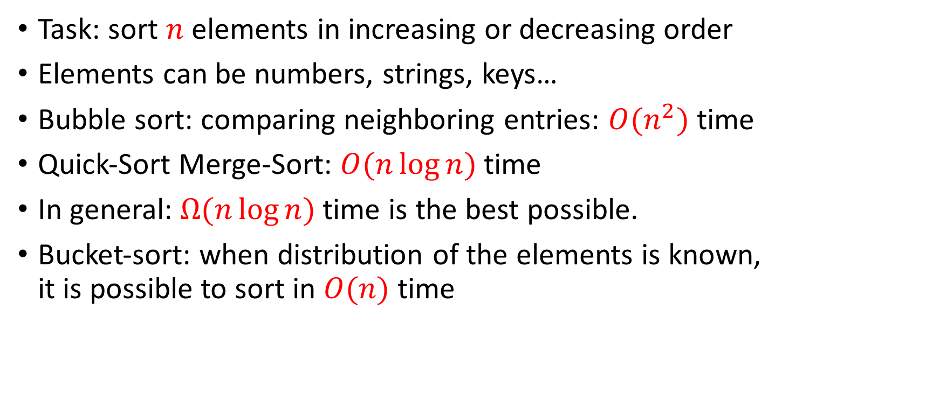
Sorting Basics
Task: sort $n$ elements in increasing or decreasing order
Elements can be numbers, strings, keys…
Bubble sort: comparing neighboring entries: $O(n^{2})$ time
Quick-Sort Merge-Sort: $O(n\log{n})$ time
In general: $Ω(n\log{n})$ time is the best possible.
Bucket-sort: when distribution of the elements is known, it is possible to sort in $O(n)$ time

Slide 3

Distributed sorting
Suppose we want to sort a file of 60 GB distributed across 6 machines.
The main bottleneck is the communication between the machines.
Ethernet
Machine 1
Machine 2
Machine 3
Machine 4
Machine 5
Machine 6
Data 1
Data 2
Data 3
Data 4
Data 5
Data 6

Slide 4





Numbers
btwn
-10 and +30
Machine 1
Splitter
Data 1
$$−5$$
$$10$$
$$14$$
$$20$$
$$25$$
Machine 1
Machine 2
Machine 3
Machine 4
Machine 5
Machine 6
Data a
Data b
Data
c
Data d
Data e
Data
f

Slide 5





Machine 1
Machine 2
Machine 3
Machine 4
Machine 5
Machine 6
Data 1
Data 2
Data 3
Data 4
Data 5
Data 6
Splitter
Splitter
Splitter
Splitter
Splitter
Splitter
$$v_{1}$$
$$v_{2}$$
$$v_{3}$$
$$v_{4}$$
$$v_{5}$$
Ethernet
Machine 1
Machine 2
Machine 3
Machine 4
Machine 5
Machine 6
Data a
Data b
Data
c
Data d
Data e
Data
f

Slide 6





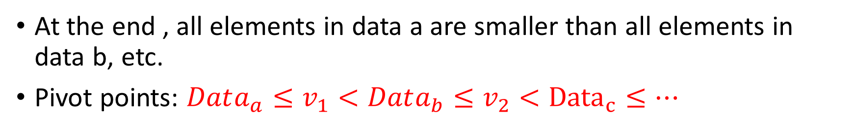
At the end , all elements in data a are smaller than all elements in data b, etc.
Pivot points: $Data_{a}≤v_{1}<Data_{b}≤v_{2}<{Data}_{c}≤⋯$
$$pivot_{1}$$
$$pivot_{2}$$
$$pivot_{3}$$
$$pivot_{4}$$
$$pivot_{5}$$
Ethernet
Machine 1
Machine 2
Machine 3
Machine 4
Machine 5
Machine 6
Data a
Data b
Data
c
Data d
Data e
Data
f

Slide 7
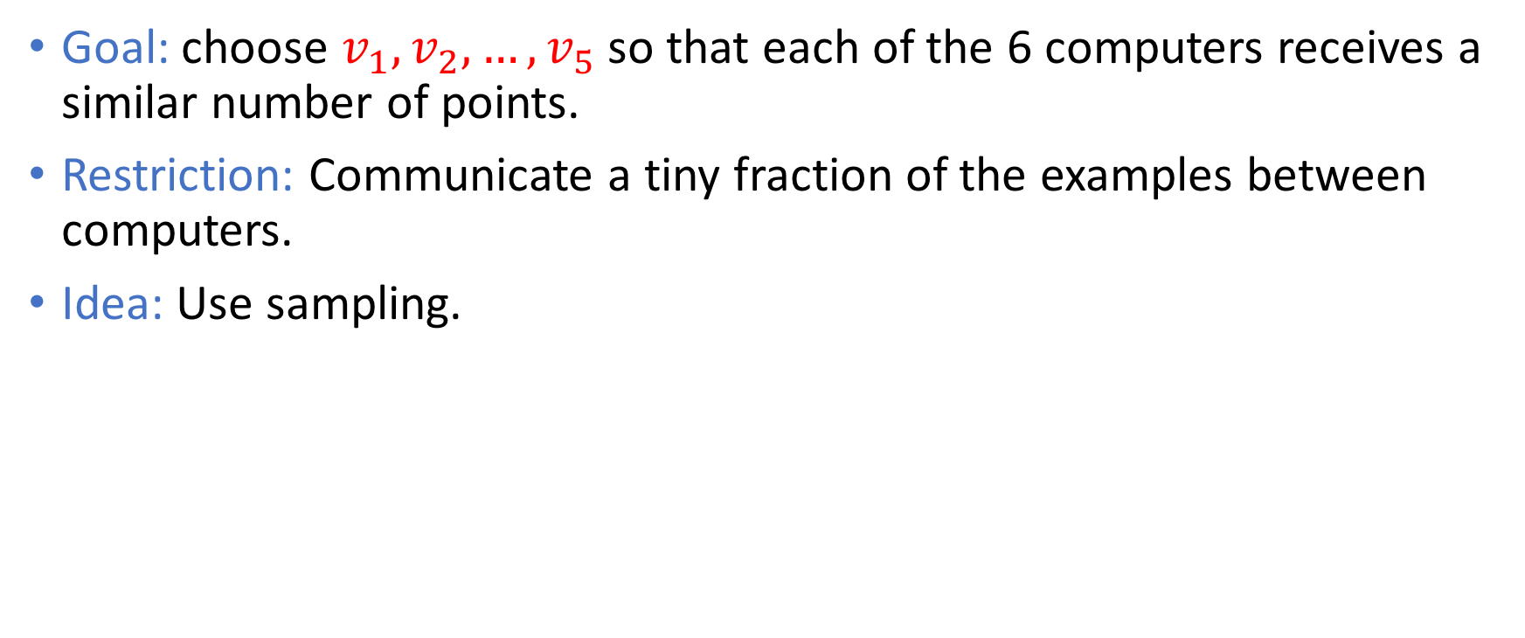
Finding good pivots
Goal: choose $v_{1},v_{2},…,v_{5}$ so that each of the 6 computers receives a similar number of points.
Restriction: Communicate a tiny fraction of the examples between computers.
Idea: Use sampling.

Slide 8
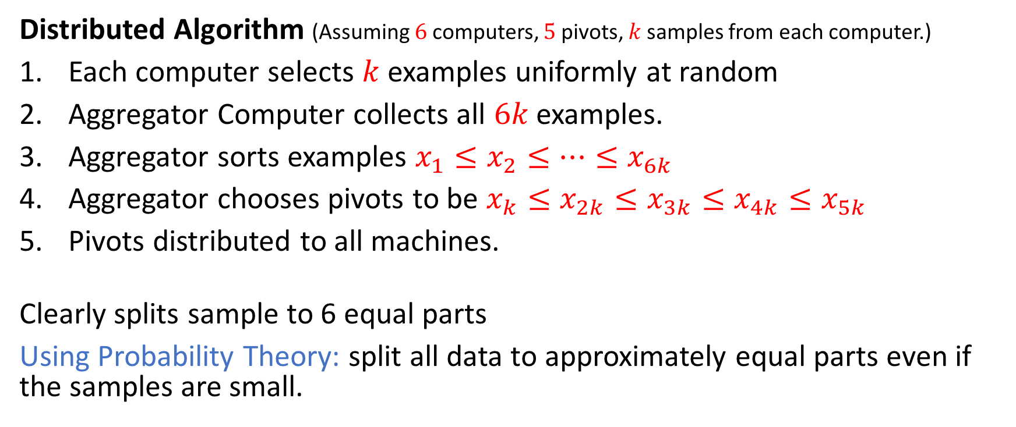
Pivot selection algorithm
Distributed Algorithm (Assuming $6$ computers, $5$ pivots, $k$ samples from each computer.)
Each computer selects $k$ examples uniformly at random
Aggregator Computer collects all $6k$ examples.
Aggregator sorts examples $x_{1}≤x_{2}≤⋯≤x_{6k}$
Aggregator chooses pivots to be $x_{k}≤x_{2k}≤x_{3k}≤x_{4k}≤x_{5k}$
Pivots distributed to all machines.
Clearly splits sample to 6 equal parts
Using Probability Theory: split all data to approximately equal parts even if the samples are small.

